Slide 1
Module 18: Editing and Compiling Object Definitions
Siebel Core Developer and Technology School
Notes:
Time: Lecture: 35 minutes; labs: 70 – 80 minutes
Intent: To discuss the operations that you can perform on object definitions: editing, verifying, compiling, and archiving.
Flow: Editing object definitions, validating object definitions, archiving object definitions, comparing object definitions, compiling object definitions, and testing a configuration.
Key Terms:
Editing
Changed flag
Validating
Exporting
Importing
Comparing
Compiling
Please note: Faculty-specific notes are italicized.

Slide 2

Module Objectives
After completing this module you will be able to:
  Create new and edit existing object definitions
  Validate edited object definitions
  Archive object definitions and projects
  Back up the local database
  Compile object definitions into a repository file
Why you need to know:
  These are all fundamental activities that occur during all configuration efforts
Notes:
Each objective and “why you need to know” should be stated aloud.

Slide 3
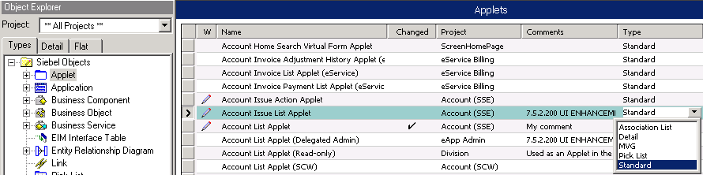
Editing Object Definitions
Select the object definition to edit using the Object Explorer and Object List Editor
  Make sure that project has been locked
Edit the property
  Type in a value
  Pick a value from a picklist (if provided)
Indicates project locked
Type in a value
Select a value
Notes:
You can edit object definitions directly in the list editor however, remember that you need to have the project locked before making any changes. You can type in values or use any picklist provided to select values. An alternative to this method is to use the Property window from Views > Windows > Properties Window to enter or edit values. Note the Project and Changed properties are not available if you use the Property window.

Slide 4
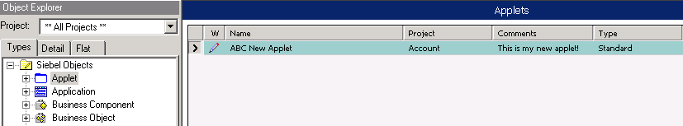
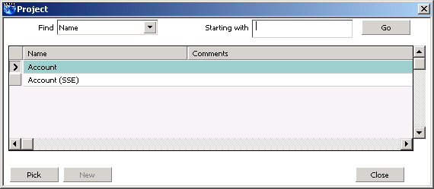
Creating a New Object Definition
Select the desired object type in the Object Explorer
Create a new record in the Object List Editor
Create a unique name
Select a project from picklist
Assign values to remaining fields
Locked projects only
Notes:
You can create a new object definition using the list editor. If it is a top-level object, then it needs to be assigned to a locked project

Slide 5
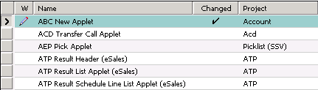
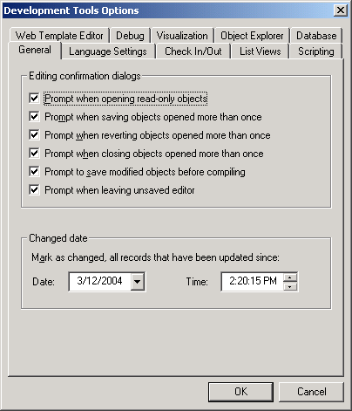
Changed Flag
Indicates records that have been modified since the Changed Date
Is set whenever a record is edited
Is cleared by resetting the Changed Date value
Notes:
The Changed flag tracks all object definitions that have been edited. It doesn’t matter if you undo the edit later, as the Changed flag will still be set. (Tools doesn’t keep track of prior values once the record is committed.) To clear the Changed flag, reset the changed date as shown on the slide.
You can see which object definitions have been modified since a specified Date and Time. Select View > Options > General tab to set Date and Time settings. A check mark appears in the Changed property if that object definition has changed since the Date and Time selected. The Changed flag does not indicate which property has changed; it only acts as an indicator that something about this object definition has changed. You will not know what values have been changed using this mechanism.
Tip: When you set the Date and Time, take an Archive of the object(s) or project(s) before you change them. You then have a backup of the object definitions before you start to modify them. If you need to know what you changed since that time, pull up the archive file and explore the differences in the property values.

Slide 6
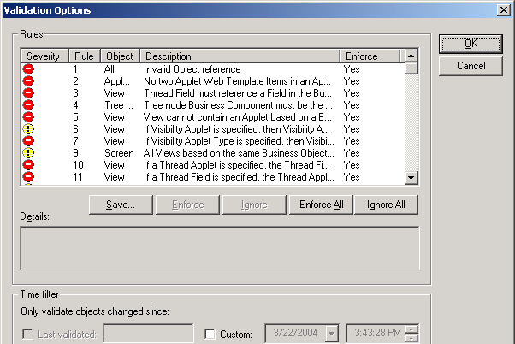
Validating Object Definitions
Determines correctness of selected object definitions in the repository
  Includes all child object definitions for the selected parent definitions
Is based on set of Siebel-defined rules
Error
Warning
User can enable/disable a Siebel-defined rule
Notes:
This slide introduces the fact that you can validate an object definition against 80 or so syntactic rules. Validating an object definition compares the object definition to a set of rules for that object type. If the object definition does not satisfy the rule, an error or a warning is reported.
This screen shot shows validation options; here we can see the 80 or so rules and whether or not they are errors or warnings. For example, rule 22 states that a business component should have at least one required field. If the business component you are validating does not have one field specified as required, then this is flagged to you when you select the Start option in the Validate window (this window is shown on next slide).
You can also decide whether or not to enforce or ignore a particular rule when performing the validation of the object definition.

Slide 7
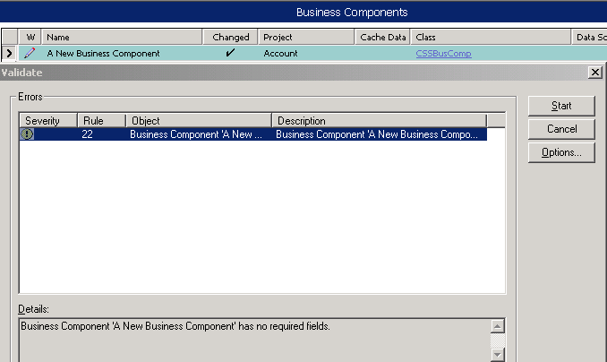
Validating Object Definitions Continued
Select object definition to validate
  Right-click and select Validate
Click Start in the Validate window
Violations appear in Errors list window
Click to access Validate Options window
Notes:
This slide shows how to validate.

Slide 8
Lab
In the lab you will:
  Practice editing and validating object definitions in Siebel Tools
Notes:
See lab instructions 18-1 for details.

Slide 9
Archive Files
Contain object definitions exported from a repository
  Available for importing into other repositories
Have .sif extension by default
Are used to share object definitions in multiple repository development
Are used to back up object definitions
Can be version-controlled using source control systems
Notes:
This slide explains archive files and how they can be used. Point out to students that it is a useful way to back up the changes to the object definitions that you are working on.
Archive files are a mechanism of exporting object definitions from a repository. The file extension is .sif. They can be used to back up object definitions or to move object definitions from one repository to another. A single object definition or several object definitions contained in one or more projects can be exported to an archive file.

Slide 10
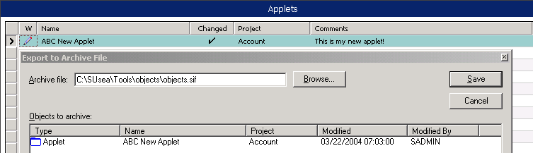
Exporting Object Definitions
Top-level object definitions can be exported to an archive file
  Includes all child object definitions for selected parent definition
To export object definitions
  Select the object definition or definitions
  Select Tools > Add to Archive
  Select an existing (or create a new) archive file
  Click Save in the Export to Archive File window
Notes:
This slide explains how to export an object definition. Again note that only top-level object definitions can be archived, and that all child definitions are included in the archive.
This slide shows an object added to an archive file. To continue to add other object definitions, repeat the Objects > Add to Archive process. To remove any object definition from the list, select it and then press the Delete key. Click the Browse button to save the file to a specified directory with a specified file name.

Slide 11
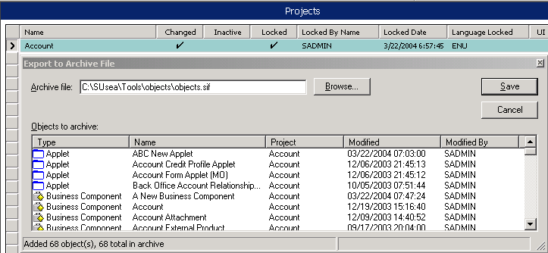
Exporting Projects
Projects can also be archived to .sif files
  Select the project (or projects) to be archived
  Select Tools > Add to Archive
  Select an existing (or create a new) archive file
  Click Save in the Export to Archive File window
Notes:
Projects can also be archived. All the object definitions contained in that project are archived.

Slide 12
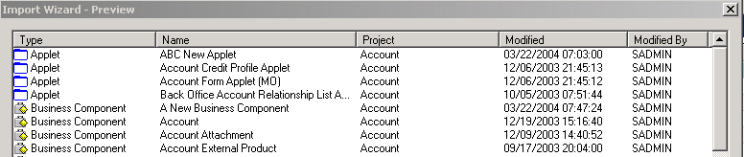
Importing Object Definitions
Object definitions in an archive file can be imported into the local repository on the developer workstation
  Appear in the current active repository
To import object definitions
  Select Tools > Import from Archive
  Select the archive file
  Indicate how to resolve conflicting object definitions
Notes:
This slide explains how to import object definitions from an archive by using Tools > Import from Archive. You will see the object definitions contained inside the archive file. Details of the object definitions include the object type, the object definition name, the project, and who and when it was modified. You cannot select individual object definitions to import from that file. Use the conflict resolution options to specify what to do with object definitions that exist in the repository and in the file. The next slide will discuss this.
This is important to know in case students need to recover from an archive file to catch up during the configuration labs.

Slide 13
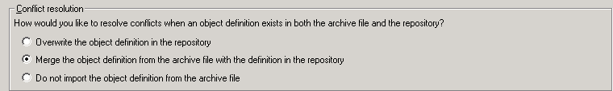
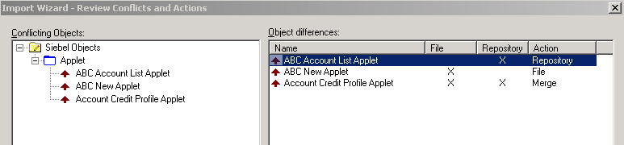

Resolve Import Conflicts
Set the default conflict resolution
Adjust individual resolutions by right-clicking them in the Object differences list
Notes:
This slide explains how to deal with conflicts between definitions in the archive and those already in the repository. You can set a default strategy (overwrite, merge, or ignore) and then adjust them on an individual basis. Merge is recommended since it preserves user changes already made to the repository while adding in definitions and properties from the archive.
Students need to understand the importing process because they will be doing it in an upcoming lab.
Conflict resolution specifies what Siebel Tools should do if the same object definition is found in the file and in the local repository.
“Overwrite the object definition in the repository” deletes the version in the target repository and its children, and replaces them with the definition(s) from the archive file.
“Merge the object definitions from the archive file with the definition in the repository” replaces those properties that are different with the ones coming from the file being imported. It adds new child object definitions to the target if they are not already present.
“Do not import the object definition from the archive” does not change object definitions in the target repository.
When you select Next, you will see which objects conflict in the next dialog box.

Slide 14
Compare Objects
Displays differences between selected object definition and another one:
  In current local repository
  In archive file
  In repository on server
Allows developers to reconcile differences while comparing objects
  Delete individual child object definitions
  Copy individual child object definitions in either direction
Notes:
A feature in Siebel Tools is the ability to compare two objects and see the differences between them. An object definition can be compared against another one in the same repository (for example, you’ve made a copy a while ago and don’t remember what you changed), against one in an archive file, or in some repository.

Slide 15
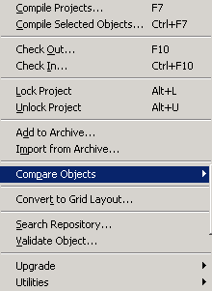

Compare Objects Continued
To compare object definition to one in archive or repository
  Select object definition to be compared
  Select Tools > Compare Objects
  Select type of comparison
  Select the archive or repository
Notes:
This slide shows how to invoke an object comparison.

Slide 16
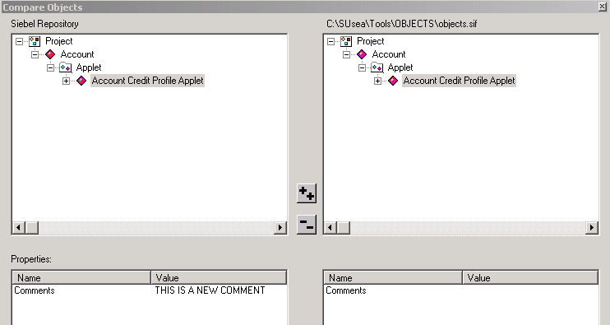
Compare Objects Continued
Examine the differences in the Compare Objects window
Definitions with difference highlighted
Differences displayed
Notes:
The differences will be highlighted in the Compare Objects window. The display uses colored icons to indicate whether two definitions are the same or different. The lower two panes show the property values that differ.

Slide 17
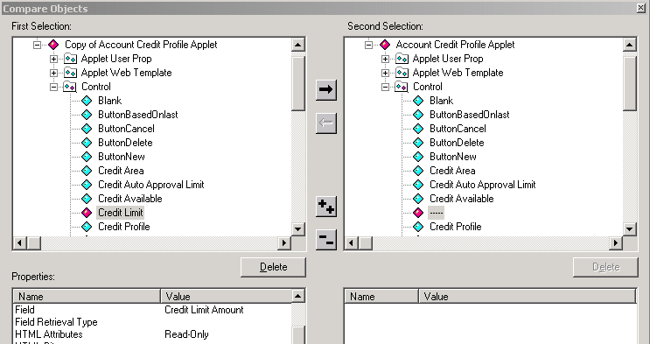
Compare Objects Continued
To compare two object definitions in the developer repository
  Select two object definitions to be compared (by shift-clicking)
  Select Tools > Compare Objects > Selected
Modifying definitions is supported
Copy selected control
Delete selected control
Notes:
A nice feature is that you can do some editing of the object definitions. You can delete or copy fields in either direction (depending upon the locked status of each object definition).

Slide 18
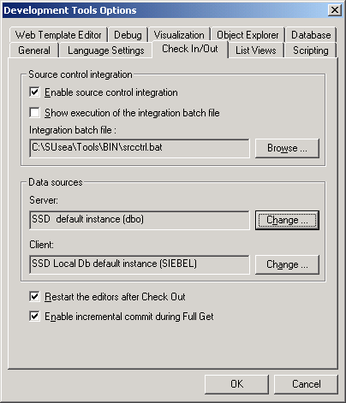
Source Code Control Integration
Automate integration with source code control for repository data
Creates archive when project checked in
Check archive into code management system
ODBC to server and local databases
Notes:
This slide briefly mentions that you can add archives to a source code control system for version management. Siebel does not version control repositories directly.
Optionally, you can integrate your check out/check in mechanism in Siebel Tools with a third-party source control system such as Microsoft SourceSafe. When source control integration is enabled, each time a project is checked in to the server repository, an archive file containing all the object definitions in the project is also checked into the source control system. As a result, successive versions of the project are maintained in the source control system.

Slide 19
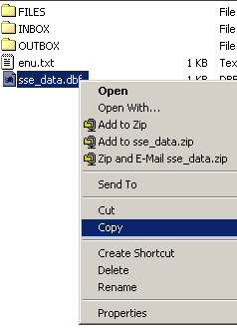
Backing Up the Development Database
Developers can back up local work by:
  Using archive files to back up repository data
  Checking in projects into the server in order to back up repository data
  Copying the local database file (.dbf) in order to back up the entire database
Add to archive
.sif
Windows copy/paste
Server
Check in
Repository Data
Notes:
This slide shows the options available to back up local work.
Use Archive files to keep backups of object definitions
Check the definitions back into the server database
Copy the local database file itself to get a backup of the entire database

Slide 20
Lab
In the lab you will:
  Explore the use of diff and archive options in Siebel Tools
Notes:
See lab 18-2 instructions for details.

Slide 21
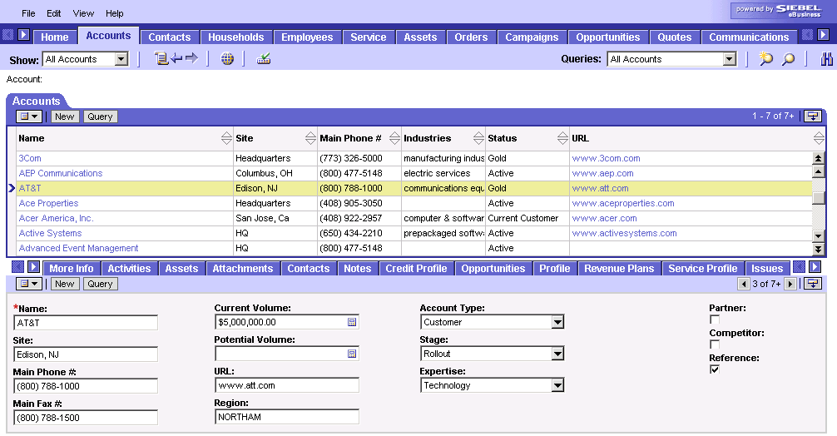
Compiling
Compile to produce an .srf file to test the configuration
  Reads object definitions from repository and creates a flat file representation to be accessed by siebel.exe at run time
Compile into .srf file located in the objects directory of the client application
Database
Tools
Application
Application
Object Manager
Repository Data
Compiling
.srf
Configured Application
Notes:
This slide reminds students about the concept of compiling. This graphic has appeared in the course a couple of times before. Stress that you compile into a .srf file in the client installation directory (not the Tools directory), even if you are using the same database.
To test the application, a repository file (.srf) needs to be compiled from within Tools. A repository file is a compressed, binary, read-only file that contains the configured object definitions that reside in the repository. A single repository file can contain the definitions for one or more applications. This file is used by the Siebel executable to read the object definitions that determine the application’s behavior. The repository definitions are held in this format for faster access.

Slide 22
Compile Options
Developers can compile
  Projects
  Individual object definitions
Notes:
This is a positioning slide that states there are two different options to compile.
Mention the options and go directly to the following slides.

Slide 23
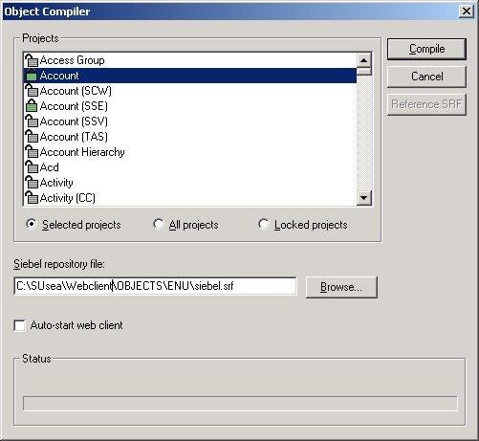
Compile Projects
When starting and at milestones, compile All Projects to generate a new .srf file
Subsequently, compile only Selected Projects or Locked Projects for an incremental compile
To compile projects:
  Select Tools > Compile
  Projects
  Select project or projects
Compile into client directory
Notes:
One choice is to compile projects. Typically you do an “all projects” compile when you start development, and at major milestones to ensure you have a clean .srf file. Otherwise, you will typically do incremental compiles of selected projects or all locked projects. Doing the latter ensures that you compile all definitions that you’ve edited. Another point to note is that when you get projects to update the local versions of those projects, you need to recompile those projects as well to include them into the .srf. Compiling locked projects won’t make that happen.

Slide 24
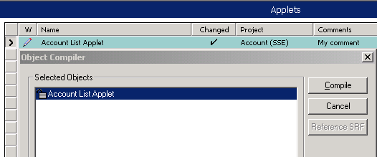
Compile Objects
Top-level object definitions can be compiled individually
  Compiles all child object definitions for the selected parent
To compile individual object definitions:
  Select the object definition or definitions
  Right-click and select Compile Selected Objects
Useful for unit testing a single changed object
  Otherwise, Compile Locked Projects
Notes:
The other choice is to compile individual object definitions. In many situations this is the preferred choice. It can be considerably quicker when the projects are large and you’ve made a change to only one or two object definitions. You can compile multiple object definitions by selecting them in the OBLE.
In most cases, the labs have students compile objects as they modify them.

Slide 25
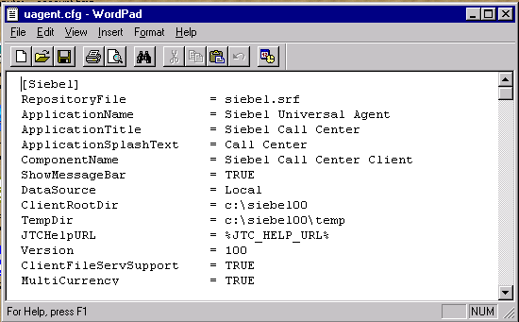
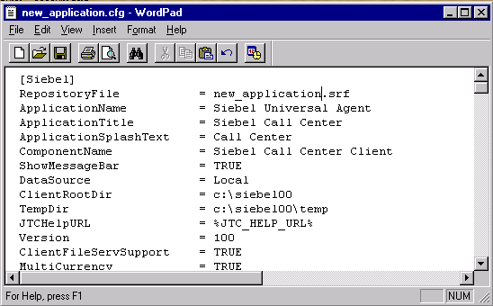
Configuration File
Copy the default .cfg file for the application being customized
Edit it to refer to the new .srf file
Copy .cfg file
Change Repository File to refer to new .srf file
Notes:
Typically you compile into a new .srf file (not the one delivered). Therefore, you need to modify the .cfg file to point to the new .srf file.

Slide 26
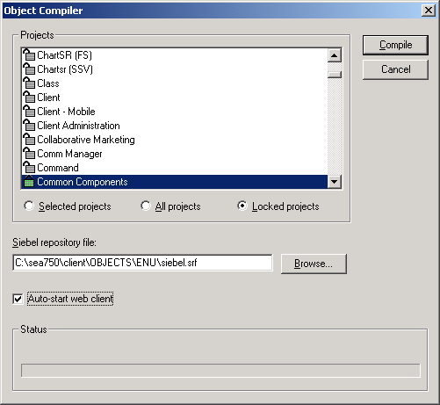

Rapid Unit Testing
Run-time behavior when user compiles SRF
  If Web client is running:
    At end of compile, browser window refreshes
    User is brought back to view displayed immediately before compile
  If Web client is not running
    If user checked auto-start, Web client is started using debug setting
    If user did not check auto-start, standard application home page opens
Allows developers to test changes in a local instance of the Mobile Web Client
Notes:
This slide identifies the two types of run-time behavior when a user compiles the SRF.
If the Web client is running, at the end of the compile the browser window refreshes and the user is brought back to the view displayed immediately before the compile, in the newly-compiled version.
If the Web client is not running, there are two possible outcomes.
1. If the user checked the "auto-start Web client" check box, the Web client is started using the debug setting and the user is brought to the standard application home page.
2. If the user did not check the auto-start check box, nothing happens.

Slide 27
Summary
This module showed you how to:
  Create new and edit existing object definitions
  Validate edited object definitions
  Archive object definitions and projects
  Back up the local database
  Compile object definitions into a repository file
Notes:
Review Question: What do you need to do first before you can edit an object definition?
Answer: Lock it.
Review Question: What does the Change Flag indicate?
Answer: It indicates records that have been modified since the Changed Date.
Review Question: What does compiling do?
Answer: Compiling produces an .srf file which reads object definitions from the repository and creates a flat file representation to be accessed by siebel.exe at run time.

Slide 28
Lab
In the lab you will:
  Compile a custom .srf file
Notes:
See lab instructions for details.

